Slide 1
Unit 2.
From World Englishes
to Globish

Slide 2
I. The rise of globish

Slide 4
Sources: Carolin Heitmann Sarah Guderian Kathrin Lübbing

Slide 5
II. Contrast of American English and Globish

Slide 6
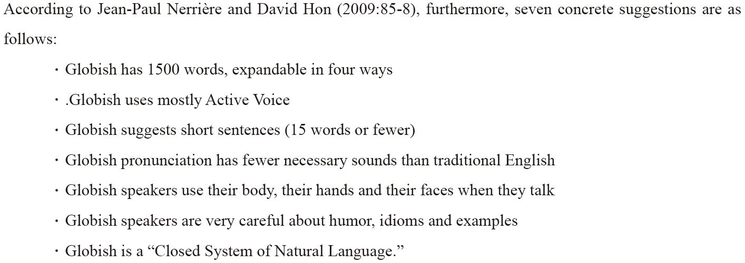

Slide 7
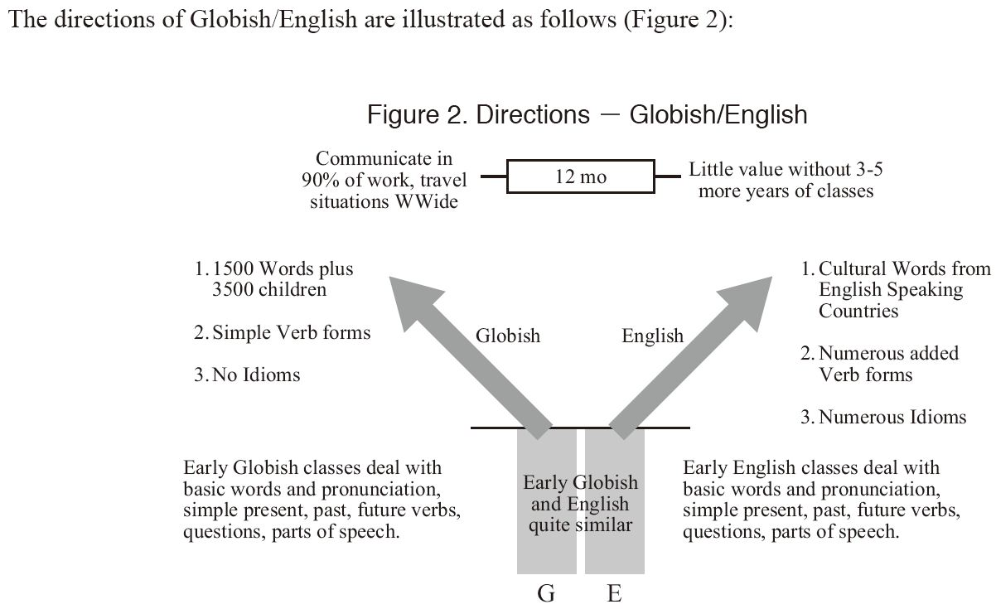

Slide 8
III. Conclusion

Slide 9
Activity 1: Give your opinion on the following questions.
Do you agree on the conclusion? Why/Why not?
When did Globish develop?
Why has World Englishes become Globish?
What’s the difference between American English and Globish?
Are you in favor of Globish English? Why/Why not?

Slide 10
Activity 2: Read and answer the following tasks.
The 1500 Globish words are useful in another way. They provide the basis for making many other words with slightly different meanings. We do that by four methods:
A. Putting words together
B. Adding a few letters to the front, or the back of a word. We call
the basic words: “fathers” and the new words: “children.”
C. Using the same word for different Parts of Speech
D. Using a preposition with verbs to make Phrasal Verbs

Slide 11
A. Putting words together
If two words are combined, you stress the first syllable.
work | + | man | =
bed | + | room | =
class | + | room | =
day | + | time | =
week | + | end | =
home | + | work | =
man | + | kind | =
air | + | plane | =
street | + | car | =
workman
bedroom
classroom
daytime
weekend
homework
mankind
airplane
streetcar

Slide 12
B. Adding a few letters to the front or the back of a word
Prefixes
1. possible = ____possible (not possible) adjective 2. correct = ____correct (not correct) adjective
3. happy = ____happy (not happy) adjective 4. new = ____new (make new again) verb 5. turn = ____turn (come back) verb
6. view = ____view (before the view) noun
im
in
un
re
re
pre
Suffixes
1. possible = possib____ (adjective to noun)
2. happy = happ____ (adjective to noun)
3. renew = renew___ (verb to noun)
4. return = return____ (verb to adjective)
5. special = special____ (adjective to adverb)
ility
iness
al
able
ily

Slide 13
C. Many times the same word can be used as a noun, a verb, and an adjective
Example:
Instruction: Find a word that can be used as a noun, a verb, and an adjective. Then, use it in a sentence.
____________________________________________________.
____________________________________________________.
____________________________________________________.
____________________________________________________.
____________________________________________________.
Book: The book is on the table. You can now book my medical exam in this list.
Review: Students review their lessons for the exam. The review was hard.
Dirty: Do not dirty my white shirt. The dirty shirt is going to be sent to my mom.
Skype: See you on Skype tonight so do not forget to Skype me then.
Record: The class record is on my desk. Everyday, she records students’ scores.

Slide 14
D. Phrasal Verbs are made with simple verbs and prepositions... in a “verb phrase”
Example:
Instruction: Use the above verb phrases in sentence. Or, look for another verb phrases and use them in sentence.
____________________________________________________.
____________________________________________________.
____________________________________________________.
____________________________________________________.
____________________________________________________.
cut off, cut down, cut back
call on, call in, call out, call off, call down
hold back, hold off, hold on, hold out, hold over, hold up
give away, give back, give in, give up, give out, give off, give over
send off, send down, send in, send up

Slide 15
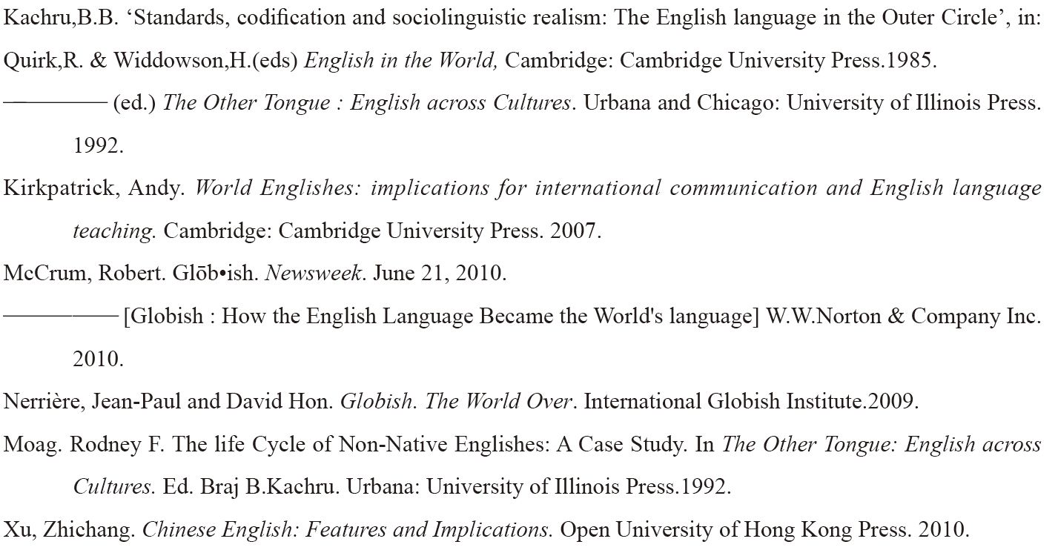
Sources
Note: Some of the texts in this material were taken from the sources below. This material is only used for classroom purpose .
Takahashi J. & Samida, D. K. (----). World Englishes: Chinese English and globish. Retrieved September 2, 2013, from http://libro.do-bunkyodai.ac.jp/research/pdf/treatises13/05-samida.pdf
:http://globishfoundation.org/gtwo-in-globish/113-chapter-17-1500-basic-globish-words-father-5000.html . Retrieved September 09, 2013.
http://wwwhomes.uni-bielefeld.de/sgramley/Foreigner%20English%20(EFL).pdf

Slide 16
Thank you!
http://suwonunivenglishian.weebly.com/
suwon univ english ian

